Slide 1
Multi-classification and visualization of an iris plant based on four features
CS-513-A Knowledge Discovery and Data Mining
Shlok Khetan
10446485
skhetan@stevens.edu

Slide 2

Shlok Arun Khetan

Slide 3
Problem Statement and goal
My goal is to develop a model capable of classifying an iris plant based on four features. This is a multi-class classification where each sample can belong to ONE of 3 classes (Iris setosa, Iris virginica or Iris versicolor). The artificial neural network(ANN) will have 4 input neurons (flower dimensions) and 3 output neurons (scores). my loss function will compare the target label (ground truth) to the corresponding output score.
The second would be to also analyze and predict the tensor with the RF(Random Forest classifier)

Slide 4
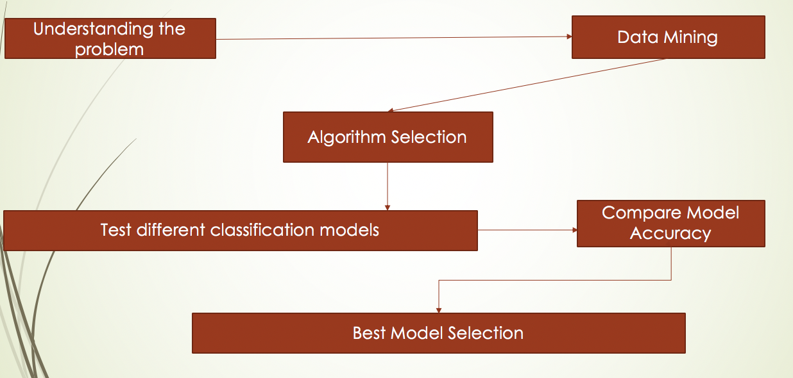
Road Map

Slide 5
Data Understanding
The columns in this dataset are:
Id
SepalLengthCm
SepalWidthCm
PetalLengthCm
PetalWidthCm
Species

Slide 6
Algorithms Used
Artificial Neural Network(A.N.N.)
Random Forest

Slide 7
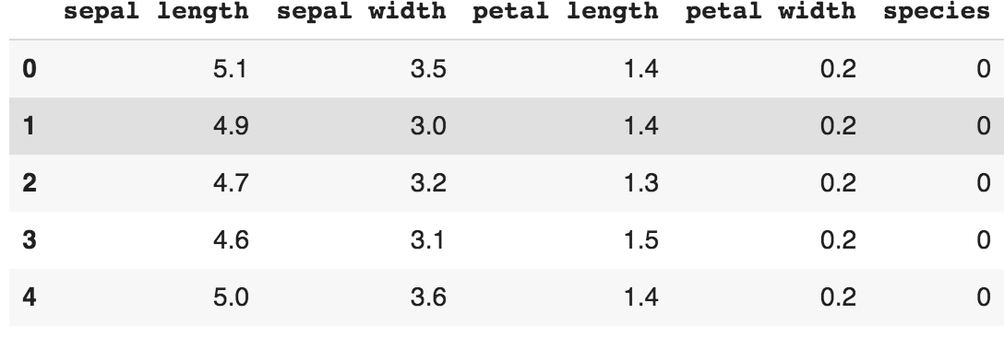
Loading the iris data set

Slide 8
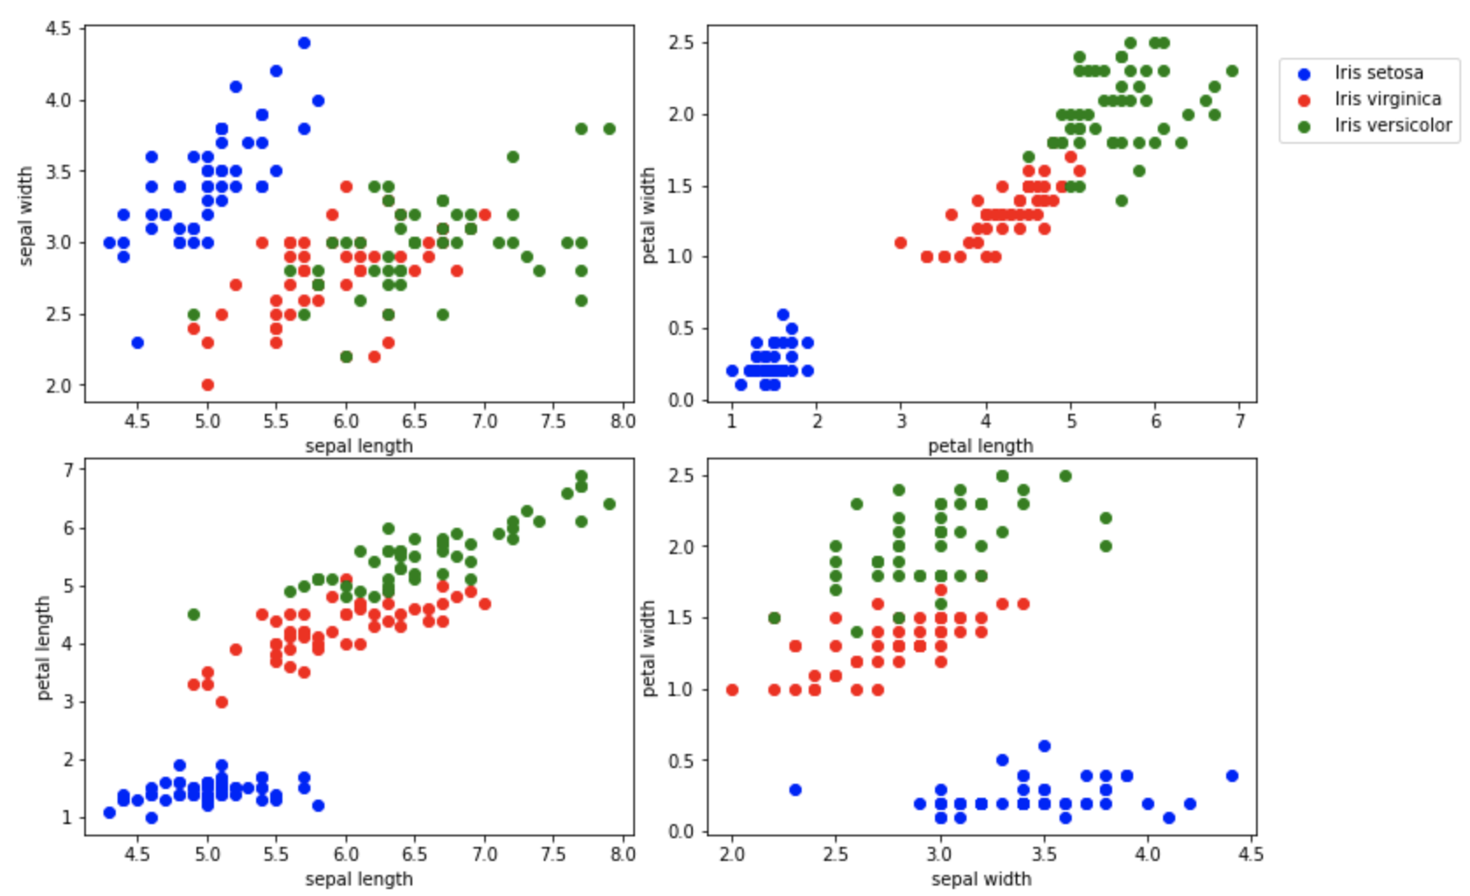
Plotting the dataset
.

Slide 9
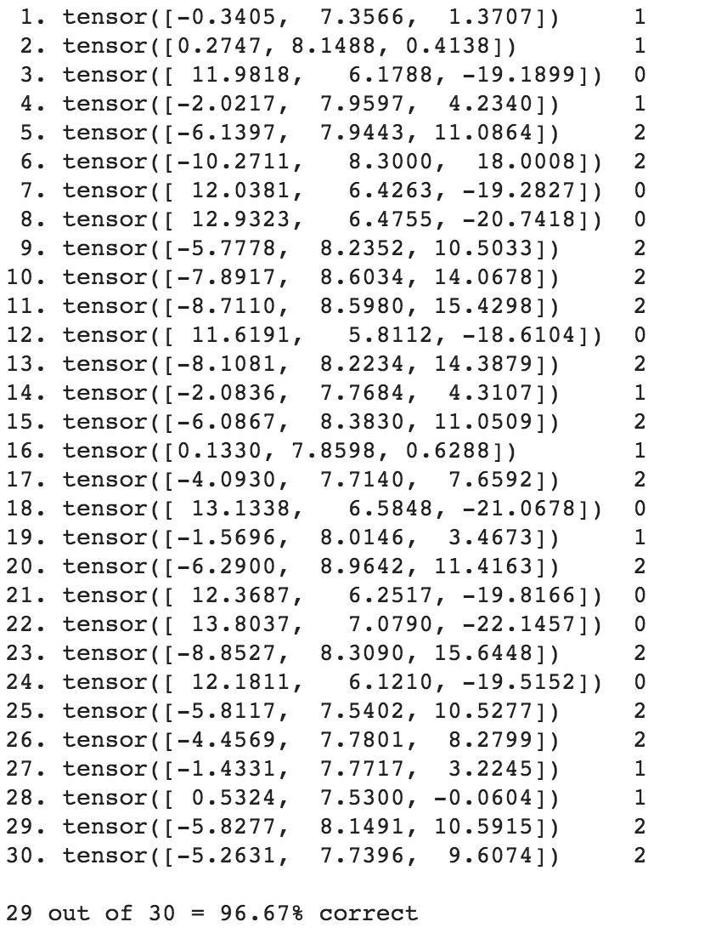
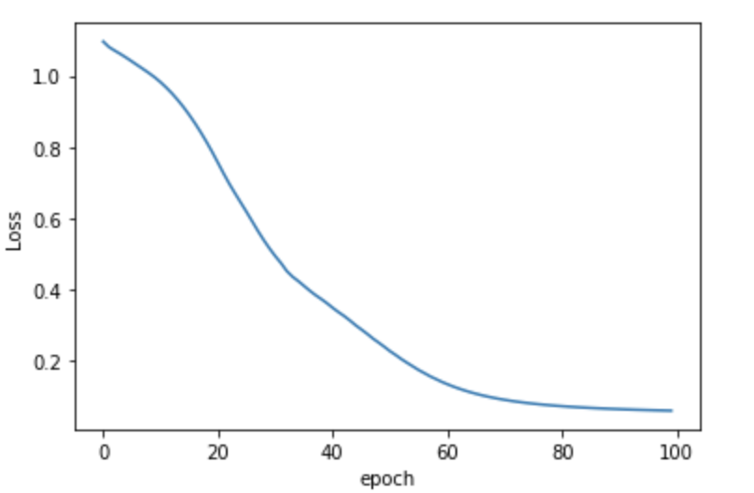
ANN Artificial Neural Network
Accuracy = 96.67% Loss graph
Loss reduces to up to 0.06543063 by the
91th epoch.

Slide 10
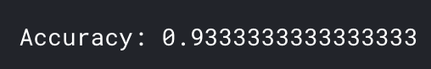
Random Forest Classifier
Random forests are an outfit learning strategy for order, relapse and different errands that work by developing a large number of choice trees at preparing time and yielding the class that is the method of the classes (characterization) or mean expectation (relapse) of the individual trees. Random choice forests right for choice trees' propensity for overfitting the training set.
Acquired Accuracy = 93.33..%

Slide 11
Modeling Complications
As the sole member working on the whole project because of time zone complications made me really appreciate the role of a data scientist.
That is why I chose a dataset which was already relatively clean and a little easier to work with.
Learnt how to effectively use python notebooks for data science

Slide 12
Conclusion
After studying different models on the dataset, it is observed that ANN
provides us the best results with the accuracy of about 96.67%, but that may change
if the dataset gets large enough as then the training of data for ANN would get tedious
Applications:
With some changes to the code it can be used in the classification of mostly any data set by shifting and changing parameters.
A website or an application can be used to launch the model for direct customer use
The model can also be extended to predict the plant’s status of other plant types, subject to availability of database.

Slide 13
Thank You!

Slide 14
Shlok Arun Khetan
skhetan@stevens.edu
10446485

